Slide 1

Software Design and Analysis Activity Diagram
Department of Computer Science
National University of Computer and Emerging Sciences

Slide 2
UML Activity Diagram
In UML, the activity diagram is used to demonstrate the flow of control within the system rather than the implementation.
It models the concurrent and sequential activities.
The activity diagram helps in envisioning the workflow from one activity to another.
The flow can be sequential, branched, or concurrent, and to deal with such kinds of flows, the activity diagram has come up with a fork, join, etc.
It is also termed as an object-oriented flowchart.

Slide 3

Components of an Activity Diagram
Symbol | Name | Description
 | Start symbol | Represents the beginning of a process or workflow in an activity diagram. It can be used by itself or with a note symbol that explains the starting point.
 | Activity symbol | The categorization of behavior into one or more actions is termed as an activity. These symbols, which include short descriptions within the shape, are the main building blocks of an activity diagram.
 | Connector symbol | Shows the directional flow, or control flow, of the activity. An incoming arrow starts a step of an activity; once the step is completed, the flow continues with the outgoing arrow.

Slide 4


Components of an Activity Diagram
Symbol | Name | Description
 | Joint symbol/ Synchronization bar | Combines two concurrent activities and re-introduces them to a flow where only one activity occurs at a time. Represented with a thick vertical or horizontal line.
 | Fork symbol | Splits a single activity flow into two concurrent activities. Symbolized with multiple arrowed lines from a join.
 | Decision symbol | Represents a decision and always has at least two paths branching out with condition text to allow users to view options. This symbol represents the branching or merging of various flows with the symbol acting as a frame or container.

Slide 5

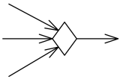
Components of an Activity Diagram
Symbol | Name | Description
 | Condition text | Placed next to a decision marker to let you know under what condition an activity flow should split off in that direction.
 | End Symbol | Marks the end state of an activity and represents the completion of all flows of a process.
 | Merge node | Merge node is a control node that brings together multiple incoming alternate flows to accept single outgoing flow. The notation for a merge node is a diamond-shaped symbol with two or more edges entering it and a single activity edge leaving it.

Slide 6




Components of an Activity Diagram
Symbol | Name | Description
 | Pin | A pin is an object node for inputs and outputs to actions. Pin is usually shown as a small rectangle attached to the action rectangle. The name of the pin can be displayed near the pin.
 | Data Store | A data store is a central buffer node for non-transient information. The data store is notated as an object node with the keyword «datastore»
 | Note Symbol | Allows the diagram creators or collaborators to communicate additional messages that don't fit within the diagram itself. Leave notes for added clarity and specification.
Notes:
Item is input pin to the Add to Shopping Cart action.
Invoice is output pin from the Create Invoice action.

Slide 7
Components of an Activity Diagram
Symbol | Name | Description
 | Send signal symbol | Indicates that a signal is being sent to a receiving activity.
 | Receive signal symbol | Demonstrates the acceptance of an event. After the event is received, the flow that comes from this action is completed.
 | Flow final symbol | Represents the end of a specific process flow. This symbol shouldn’t represent the end of all flows in an activity
Notes:
Item is input pin to the Add to Shopping Cart action.
Invoice is output pin from the Create Invoice action.

Slide 8
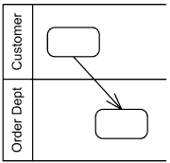
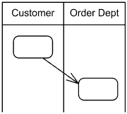
Components of an Activity Diagram
Activity partition /swimlane:
The swimlane is used to cluster all the related activities in one column or one row.
It can be either vertical or horizontal.
It used to add modularity to the activity diagram.
It is not necessary to incorporate swimlane in the activity diagram.
But it is used to add more transparency to the activity diagram.
Activity partitions Customer and Order Dept as horizontal swimlanes.
Activity partitions Customer and Order Dept as vertical swimlanes.

Slide 9
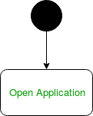
Activity Diagram Notations
Initial State:
Initial State – The starting state before an activity takes place is depicted using the initial state.
UML-State-Diagram Figure – notation for initial state or start state A process can have only one initial state unless we are depicting nested activities.
We use a black filled circle to depict the initial state of a system. For objects, this is the state when they are instantiated.
The Initial State from the UML Activity Diagram marks the entry point and the initial Activity State.
For example – Here the initial state is the state of the system before the application is opened.
Figure – initial state symbol being used

Slide 10
Activity Diagram Notations
Action or Activity State:
An activity represents execution of an action on objects or by objects. We represent an activity using a rectangle with rounded corners. Basically any action or event that takes place is represented using an activity.
Figure – activity state symbol being used

Slide 11
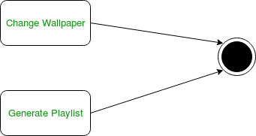
Activity Diagram Notations
Action Flow or Control flows :
Action flows or Control flows are also referred to as paths and edges.
They are used to show the transition from one activity state to another.
UML-Object-Diagram Figure – notation for control Flow An activity state can have multiple incoming and outgoing action flows.
We use a line with an arrow head to depict a Control Flow.
If there is a constraint to be adhered to while making the transition it is mentioned on the arrow.
Consider the example – Here both the states transit into one final state using action flow symbols i.e. arrows.

Slide 12
Activity Diagram Notations
Action Flow or Control flows :
Action flows or Control flows are also referred to as paths and edges.
They are used to show the transition from one activity state to another.
UML-Object-Diagram Figure – notation for control Flow An activity state can have multiple incoming and outgoing action flows.
We use a line with an arrow head to depict a Control Flow.
If there is a constraint to be adhered to while making the transition it is mentioned on the arrow.
Consider the example – Here both the states transit into one final state using action flow symbols i.e. arrows.
Figure – using action flows for transitions

Slide 13
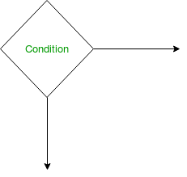
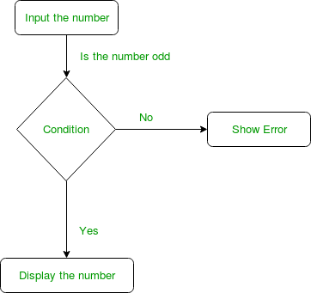
Activity Diagram Notations
Decision node and Branching :
When we need to make a decision before deciding the flow of control, we use the decision node.
The outgoing arrows from the decision node can be labelled with conditions or guard expressions. It always includes two or more output arrows.
Figure – notation for decision node
Figure – an activity diagram using decision node

Slide 14
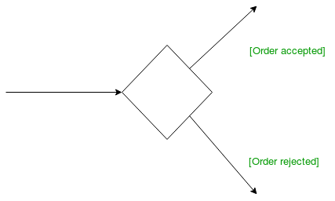
Activity Diagram Notations
Guards:
A Guard refers to a statement written next to a decision node on an arrow sometimes within square brackets.
Figure – guards being used next to a decision node The statement must be true for the control to shift along a particular direction. Guards help us know the constraints and conditions which determine the flow of a process.

Slide 15
Activity Diagram Notations
Fork:
Fork nodes are used to support concurrent activities.
UML-Activity-Diagram Figure – fork notation When we use a fork node when both the activities get executed
concurrently i.e. no decision is made before splitting the activity into two parts.
Both parts need to be executed in case of a fork statement.
We use a rounded solid rectangular bar to represent a Fork notation with incoming arrow from the parent activity state
and outgoing arrows towards the newly created activities.
For example: In the example below, the activity of making coffee can be split into two concurrent activities and hence we use the fork notation..

Slide 16
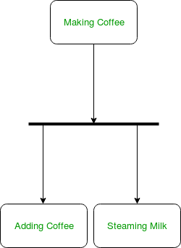
Activity Diagram Notations
Fork:
Figure – a diagram using fork.

Slide 17
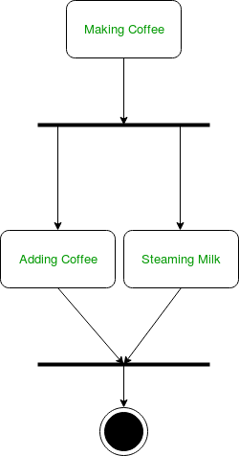
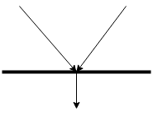
Activity Diagram Notations
Join:
Join nodes are used to support concurrent activities converging into one.
For join notations we have two or more incoming edges and one outgoing edge.
UML-Activity-Diagram Figure – join notation For example – When both activities i.e. steaming the milk and adding coffee get completed, we converge them into one final activity.
Figure – Join notation in UML.

Slide 18
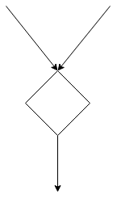
Activity Diagram Notations
Merge or Merge Event :
Scenarios arise when activities which are not being executed concurrently have to be merged.
We use the merge notation for such scenarios.
We can merge two or more activities into one if the control proceeds onto the next activity irrespective of the path chosen.
UML-Activity-Diagram Figure – merge notation For example –
In the diagram below: we can’t have both sides executing concurrently,
but they finally merge into one. A number can’t be both odd and even at the same time.
Figure – Merge symbol in UML.

Slide 19
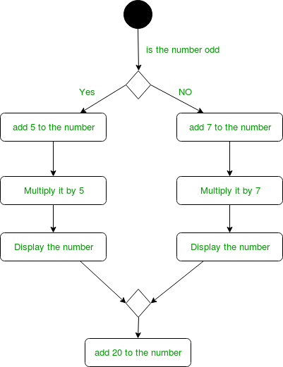
Activity Diagram Notations
Merge or Merge Event :
Figure – Merge symbol in UML.

Slide 20
Activity Diagram Notations
Swimlanes:
We use swimlanes for grouping related activities in one column.
Swimlanes group related activities into one column or one row.
Swimlanes can be vertical and horizontal.
Swimlanes are used to add modularity to the activity diagram.
It is not mandatory to use swimlanes.
They usually give more clarity to the activity diagram.
It’s similar to creating a function in a program.
It’s not mandatory to do so, but, it is a recommended practice.
UML-Activity-Diagram Figure – We use a rectangular column to represent a swimlane as shown in the figure above.
For example – Here different set of activities are executed based on if the number is odd or even. These activities are grouped into a swimlane..

Slide 21
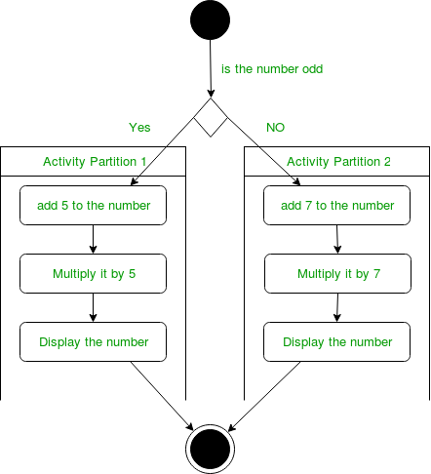
Activity Diagram Notations
Swimlanes:

Slide 22
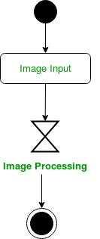

Activity Diagram Notations
Time Event:
We can have a scenario where an event takes some time to complete.
We use an hourglass to represent a time event.
For example – Let us assume that the processing of an image takes a lot of time. Then it can be represented as shown below.
Figure – an activity diagram using time event
Figure – time event notation

Slide 23

Activity Diagram Notations
Final State or End State:
The state which the system reaches when a particular process or activity ends is known as a Final State or End State. We use a filled circle within a circle notation to represent the final state in a state machine diagram. A system or a process can have multiple final states.
UML-State-Diagram Figure – notation for final state.

Slide 24
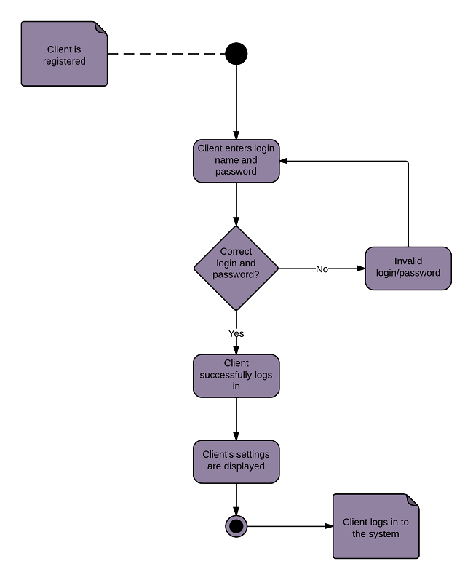
Activity diagram for a login

Slide 25
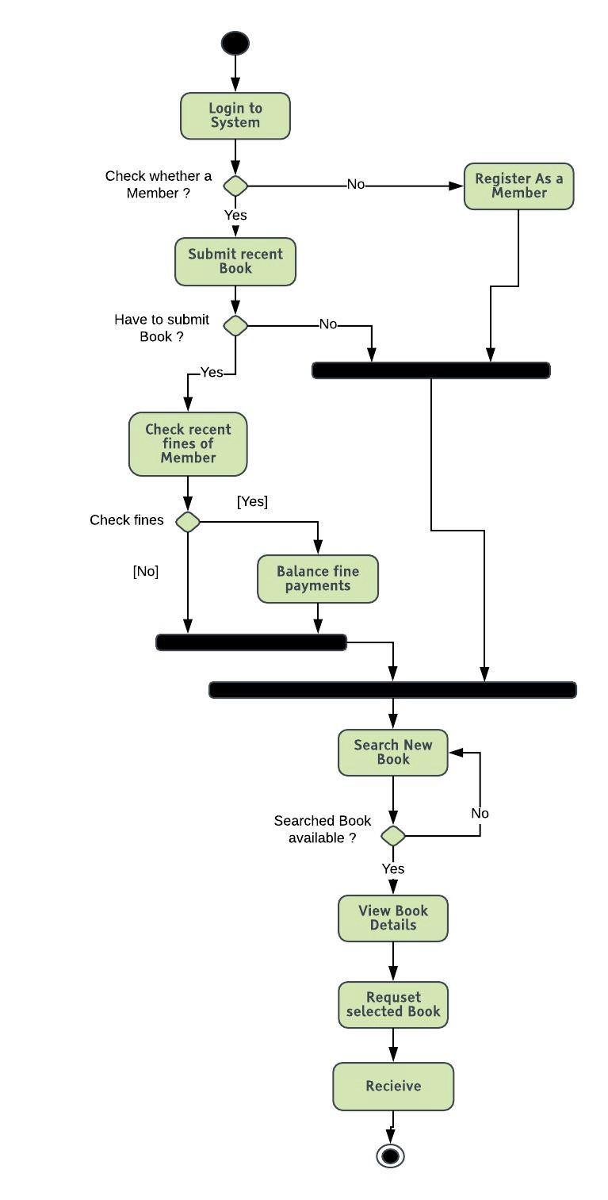
Activity diagram for Library Management System

Slide 26
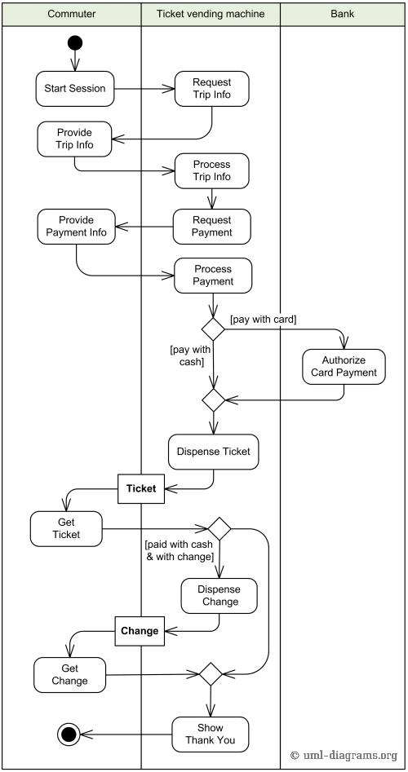
Activity diagram for Ticket Vending Machine
This diagram uses the concept of swam lanes.
Thus categorize/partition the activities w.r.t the actors.
Vertical swam lanes are used.

Slide 27
Activity diagram for Order Processing
[order reject]
Receive
Fill
Ship
Close
Order
Order
Order
Order
[order
accepted]
Send
Invoice
Accept
Invoice
Make Payment
Payment

Slide 28
When to use an Activity Diagram?
An activity diagram can be used to portray business processes and workflows. Also, it used for modeling business as well as the software. An activity diagram is utilized for the followings:
To graphically model the workflow in an easier and understandable way.
To model the execution flow among several activities.
To model comprehensive information of a function or an algorithm employed within the system.
To model the business process and its workflow.
To envision the dynamic aspect of a system.

Slide 29
End of Lecture Any Question ?

